Slide 1
Right-Time Right-Game
Presented by: Saurab Jain
Supervised by: Adarsh Jain

Slide 2
Introduction
Almost all mobile game applications, send daily message to all users.
Challenge here is to decide when to send that message. So that user come back and engage in the game.

Slide 3
How to send message in right time?
Practically with the help of supervised and unsupervised machine learning algorithms it is impossible to achieve right time with high accuracy. So, I used Reinforcement Learning to achieve good accuracy.

Slide 4
What is Reinforcement Learning?
Reinforcement learning is the training of machine learning models to make a sequence of decisions. The agent learns to achieve a goal in an uncertain, potentially complex environment.

Slide 5
Terminologies in RL
State: The current situation
Action: Action is what an agent can do in each state.
Reward: When an agent takes an action in each state, it received a reward from the environment.
Environment: Everything agents interact with is called an environment.
Agent: The agent is one who takes decisions based on the rewards and punishments

Slide 6
Reinforcement Learning Setup:
State: Day and time based on user location and last notification sent. More on state in next slide.
Action: either send notification or not
Reward: If notification not send 0 reward and, if send and user interact reward +3, if it ignores than rewards -1. (We can increase rewards criteria)

Slide 7
More on State
I have split time on 4 parts which is morning, afternoon, evening and sleeping. So, values accordingly 0,1,2,3
Day in 7 parts i.e. all days of week and corresponding values 0,1,2,3,4,5,6
Another feature is last notification, it takes two value 0 and 1, where 0 means the notification is send within an hour and 1 means not within an hour.

Slide 8
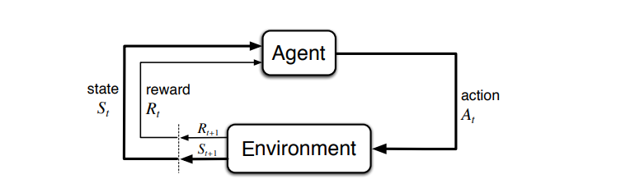
MDP: Markov Decision Process

Slide 9
Transition from state to next state
I have added a stepSizeMinute variable in environment which will decide when the next state will be. For e.g. if stepSizeMinute is 30 min then next state will be 30 minute after previous state.

Slide 10
Environment Build up:
I used OpenAI Gym to build custom environment.
The main functions in Environment are:
__init__: initialize the attributes of environment class.
reset: It give the initial state of the environment.
Step: Given an action taken by agent it will provide new state and reward to the agent, and also it will give the information that an episode is end or not.

Slide 11
Initial Attributes of Environment are:
Reward Criteria: We will provide the reward criteria to environment.
Environment: For each user, we store the probability distribution of user respond in each state.
Episode Length Day: We provide the length of each episode.

Slide 12
Agent:
I have used Q-learning algorithm to build agent policy.

Slide 13
Q- Learning Algorithm
Q-Learning is a value-based reinforcement learning algorithm which is used to find the optimal action-selection policy using a Q function.
Our goal is to maximize the value function Q.
Q(state, action) returns the expected future reward of that action at that state.
Equation: Q(s,a) = Q(s,a) + α[R(s,a) + γ*maxQ’(s’,a) – Q(s,a)]

Slide 14
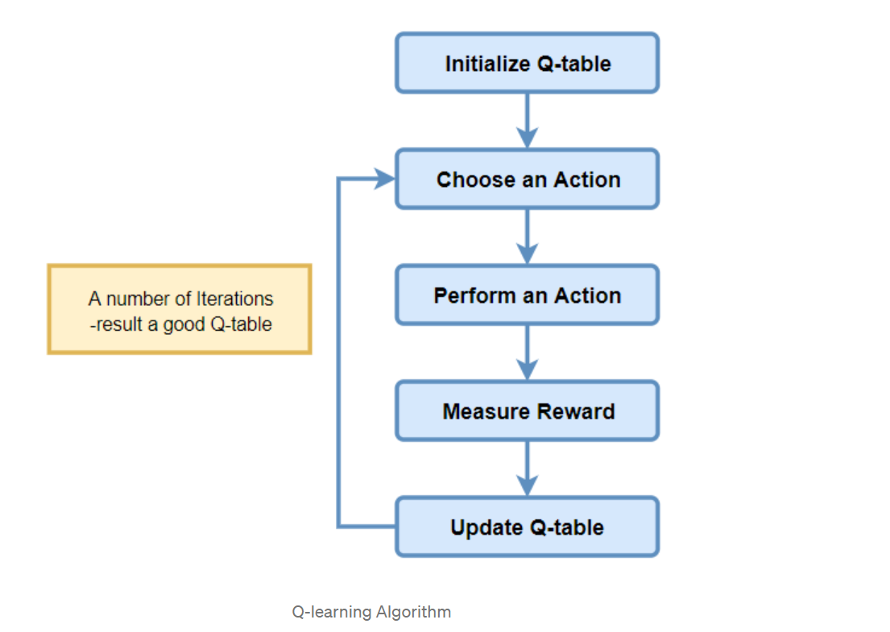

Slide 15
Now that we get idea of our environment and agent. Lets see how our agent perform in a user who prefers to play more in morning.

Slide 16
What more we can do?
We can increase the number of states
We can add more features like user interaction time with the app
We can use DQN (Deep Q- Learning) agent and more other agents algorithms

Slide 17
References
Nurture: https://par.nsf.gov/servlets/purl/10111008 (push notification method)
Zynga: https://towardsdatascience.com/deep-reinforcement-learning-in-production-part-2-personalizing-user-notifications-812a68ce2355

Slide 18
Thanks and Credit to
Adarsh Sir

